Slide 1
Dijkstra’s Algorithm
CSC 321: Analysis and design algorithms
Dr. Saleh Albelwi

Slide 2
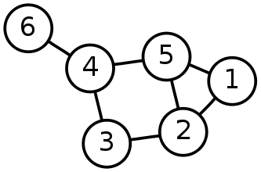
Single-Source Shortest Path Problem
Single-Source Shortest Path Problem - The problem of finding shortest paths from a source vertex v to all other vertices in the graph.

Slide 3
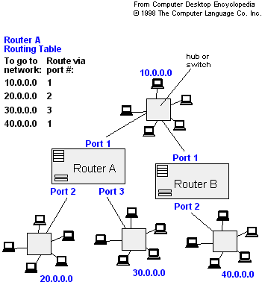
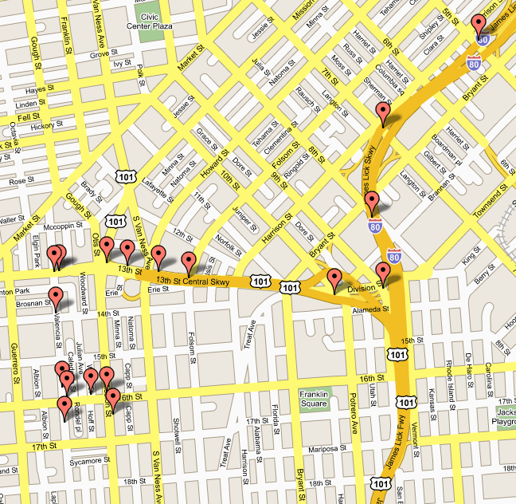
Applications
Maps - Google Maps : driving direction
Routing Systems
Flight reservation
Internet packet routing
Flight reservations
Driving directions

Slide 4
Dijkstra's algorithm
Dijkstra's algorithm - is a solution to the single-source shortest path problem in graph theory.
Works on both directed and undirected graphs. However, all edges must have non-negative weights.
Input: Weighted graph G={E,V} and source vertex v∈V, such that all edge weights are non-negative.
Output: Lengths of shortest paths (or the shortest paths themselves) from a given source vertex v∈V to all other vertices

Slide 5
Approach
The algorithm computes for each vertex u in V the distance from start vertex s to vertex u, that is, the weight of a shortest path between s and u.
the algorithm keeps track of the set of vertices for which the distance has been computed, called the cloud C.
Every vertex u in V has a label D associated with it. For any vertex u, D[u] stores an approximation of the distance between s and u. The algorithm will update a D[u] value when it finds a shorter path from s to u.
When a vertex u is added to the cloud, its label D[u] is equal to the actual (final) distance between the starting vertex s and vertex u.

Slide 6
Edge relaxation
2
4
s
u
v
2
2
4
∞
s
u
v
The relaxation process in Dijkstra's algorithm refers to updating the cost of all vertices connected to a vertex u, if those costs would be improved by including the path via v.
If (d[u]+ w(u,v)<d[v])
d[v]=d[u]+w[u,v]
2
2
4
6
s
u
v

Slide 7
Example: Initialization
Distance(source) = 0
0
∞
Distance (all vertices but source) = ∞
A
2
B
4
1
3
10
∞
C
2
D
2
E
∞
5
8
∞
4
6
F
1
G
∞
∞
Pick vertex in List with minimum distance.

Slide 8
Example: Update neighbors' distance
0
2
A
2
B
4
1
3
10
∞
C
2
D
2
E
∞
5
8
1
4
6
Distance(B) = 2
F
1
G
Distance(D) = 1
∞
∞

Slide 9
Example: Remove vertex with minimum distance
0
2
A
2
B
4
1
3
10
∞
C
2
D
2
E
∞
5
8
1
4
6
F
1
G
∞
∞
Pick vertex in List with minimum distance, i.e., D

Slide 10
Example: Update neighbors
0
2
A
2
B
4
1
3
10
3
C
2
D
2
E
3
5
8
1
4
6
Distance(C) = 1 + 2 = 3 Distance(E) = 1 + 2 = 3 Distance(F) = 1 + 8 = 9 Distance(G) = 1 + 4 = 5
F
1
G
9
5

Slide 11
Example: Continued...
Pick vertex in List with minimum distance (B) and update neighbors
0
2
A
2
B
4
1
3
10
3
C
2
D
2
E
3
5
8
1
4
6
Note : distance(D) not updated since D is already known and distance(E) not updated since it is larger than previously computed
F
1
G
9
5

Slide 12
Example: Continued...
Pick vertex List with minimum distance (E) and update neighbors
0
2
A
2
B
4
1
3
10
3
C
2
D
2
E
3
5
8
1
4
6
F
1
G
No updating
9
5

Slide 13
Example: Continued...
Pick vertex List with minimum distance (C) and update neighbors
0
2
A
2
B
4
1
3
10
3
C
2
D
2
E
3
5
8
1
4
6
Distance(F) = 3 + 5 = 8
F
1
G
8
5

Slide 14
Example: Continued...
Pick vertex List with minimum distance (G) and update neighbors
0
2
A
2
B
4
1
3
10
3
C
2
D
2
E
3
5
8
1
4
6
F
1
G
Previous distance
6
5
Distance(F) = min (8, 5+1) = 6

Slide 15
Example (end)
0
2
A
2
B
4
1
3
10
3
C
2
D
2
E
3
5
8
1
4
6
F
1
G
6
5
Pick vertex not in S with lowest cost (F) and update neighbors

Slide 16
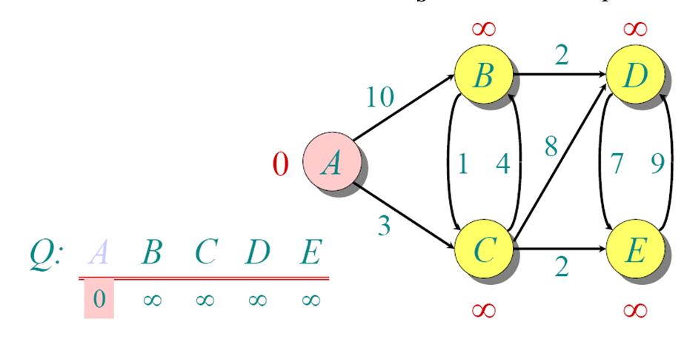
Another Example

Slide 17
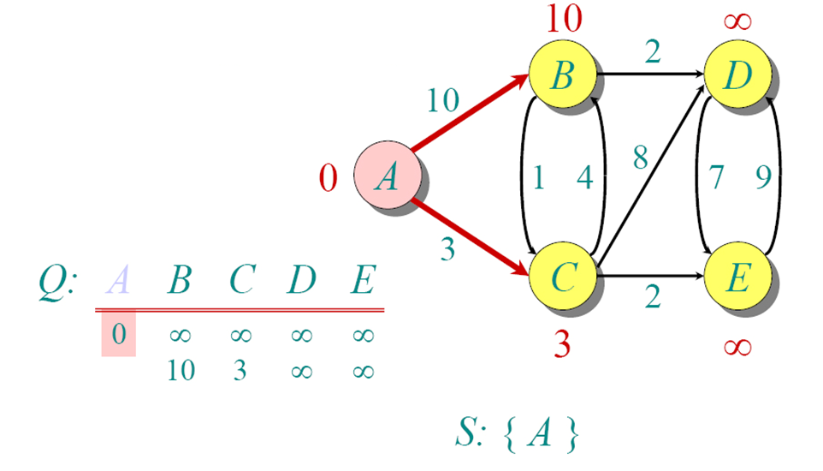
Another Example

Slide 18
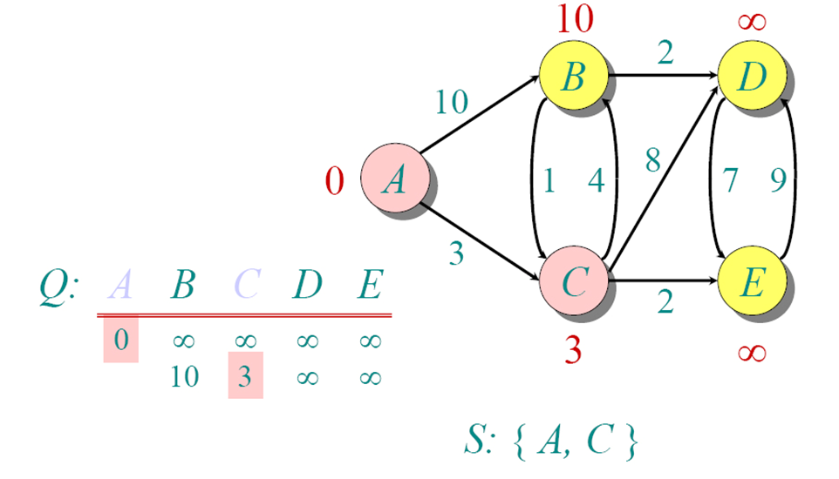
Another Example

Slide 19
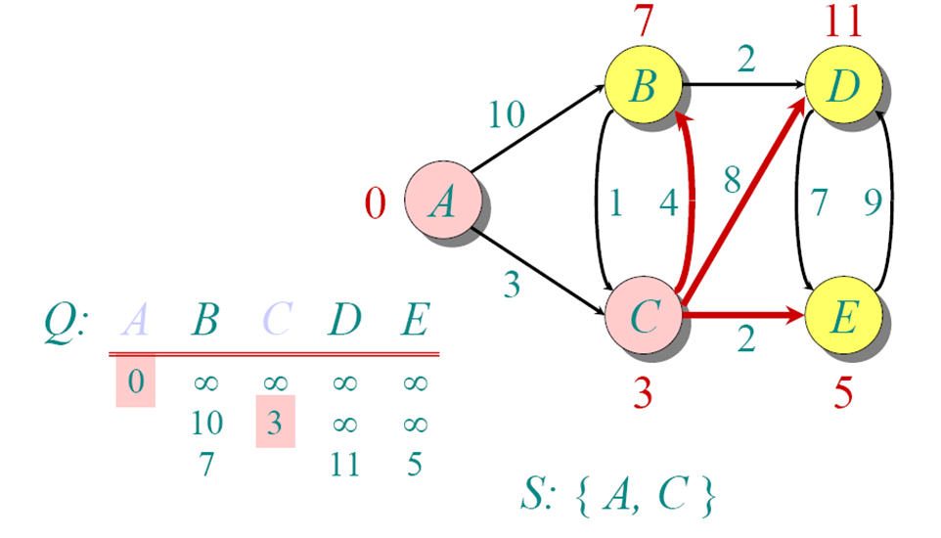
Another Example

Slide 20
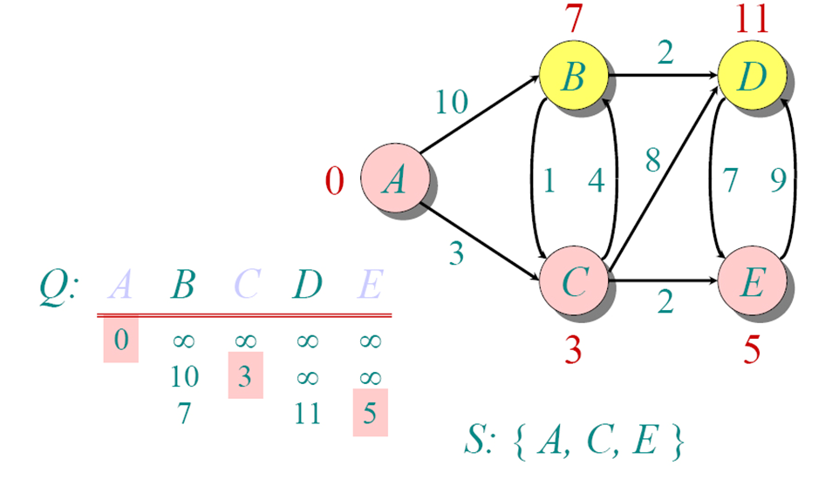
Another Example

Slide 21
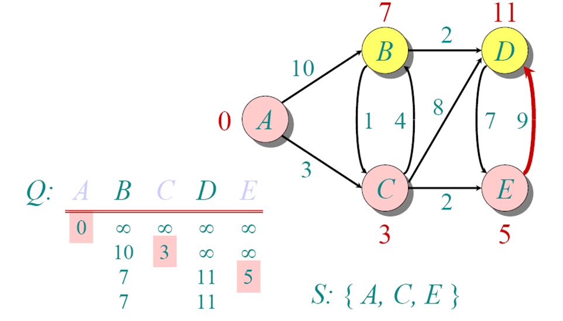
Another Example

Slide 22
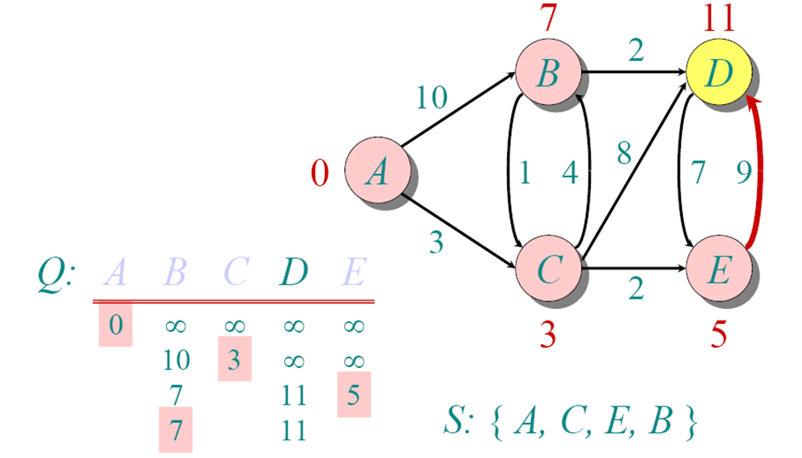
Another Example

Slide 23
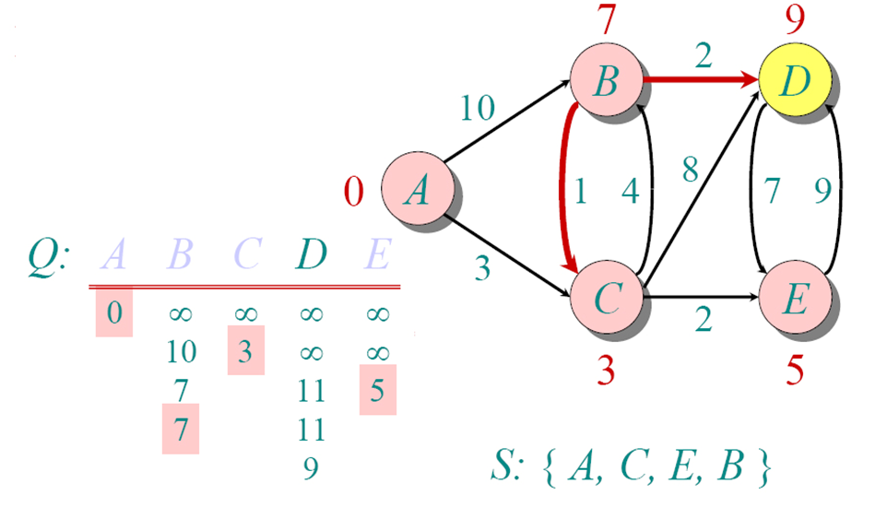
Another Example

Slide 24
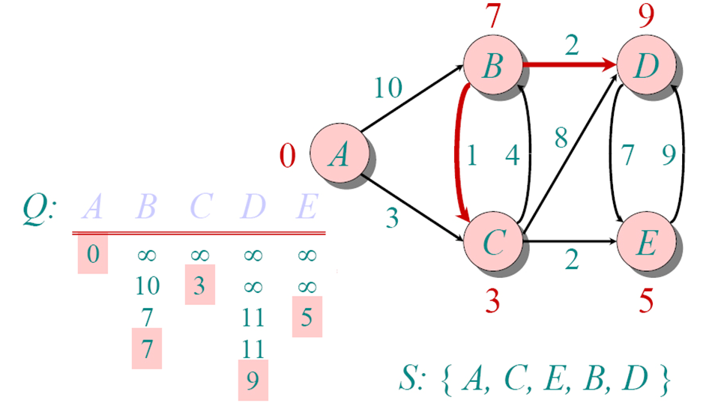
Another Example

Slide 25
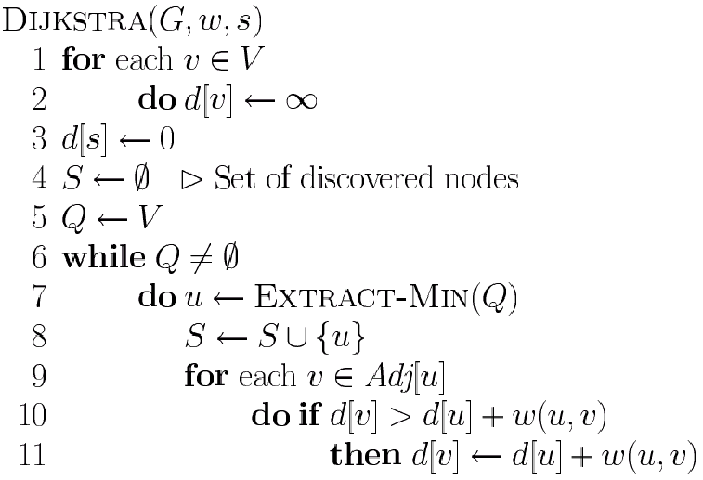
Dijkstra’s Pseudo Code
Graph G, weight function w, root s
relaxing edges

Slide 26
Time Complexity: Using List
The simplest implementation of the Dijkstra's algorithm stores vertices in an ordinary linked list or array
Good for dense graphs (many edges)
|V| vertices and |E| edges
Initialization O(|V|)
While loop O(|V|)
Find and remove min distance vertices O(|V|)
Potentially |E| updates
Update costs O(1)
Total time O(|V²| + |E|) = O(|V²| )

Slide 27
Time Complexity: Priority Queue
For sparse graphs, (i.e. graphs with much less than |V²| edges) Dijkstra's implemented more efficiently by priority queue
Initialization O(|V|) using O(|V|) buildHeap
While loop O(|V|)
Find and remove min distance vertices O(log |V|) using O(log |V|) deleteMin
Potentially |E| updates
Update costs O(log |V|) using decreaseKey
Total time O(|V|log|V| + |E|log|V|) = O(|E|log|V|)
|V| = O(|E|) assuming a connected graph

